Slide 1
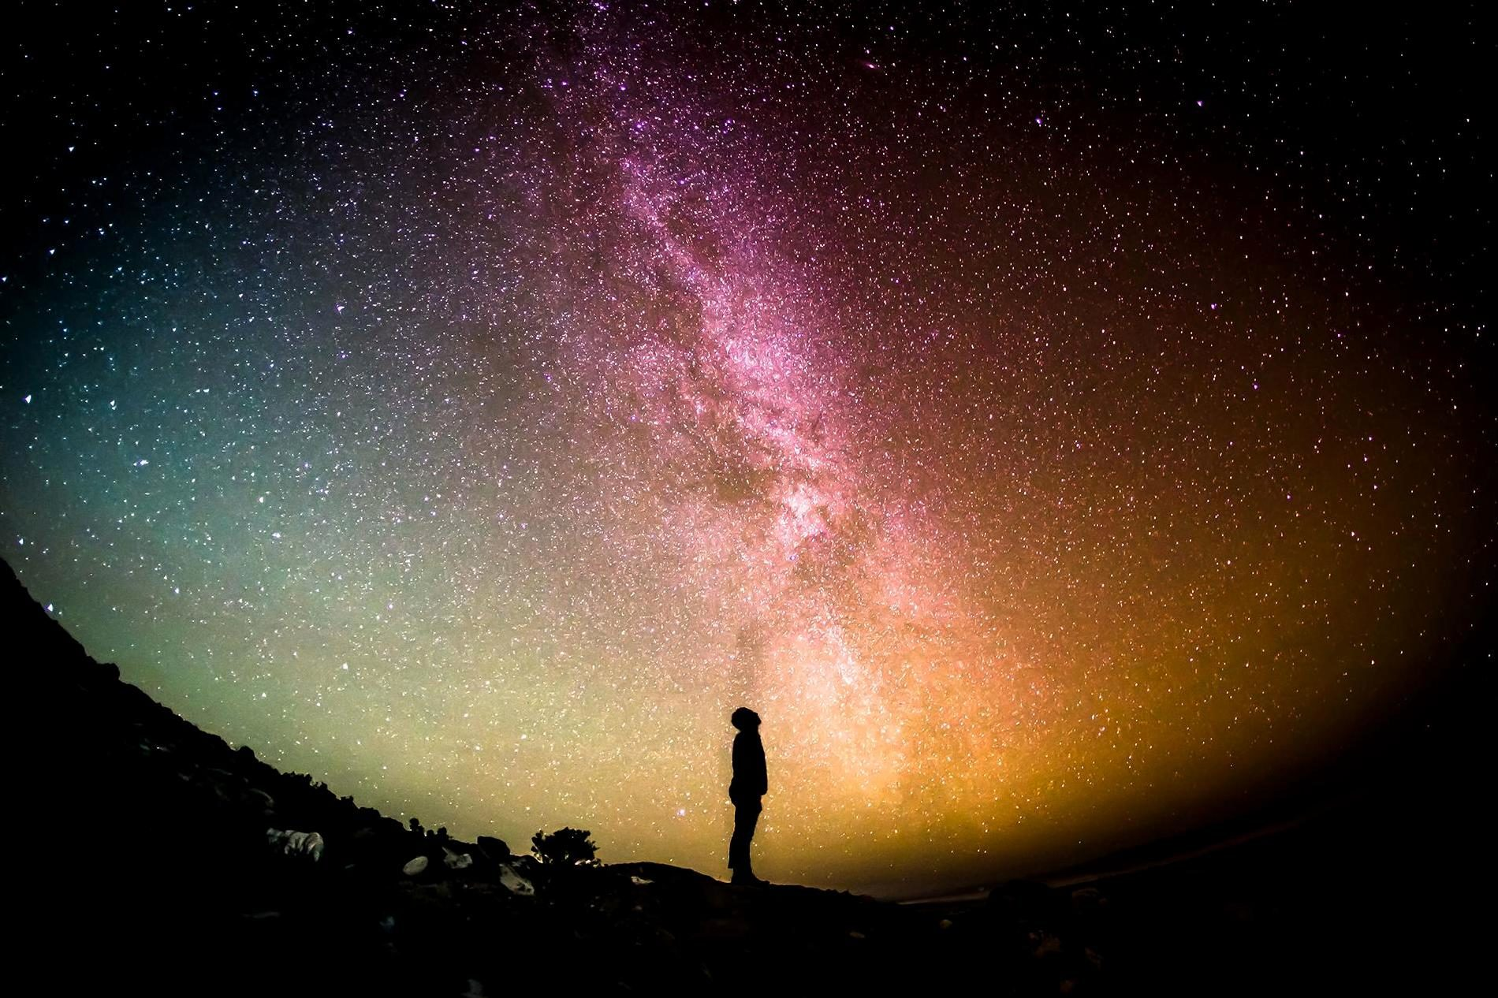
LOOP
To Infinity and Beyond
Notes:
The goal of my project is to see if I can contribute to the exoplanets search using new tools such as Warp10 and TensorFlow.

Slide 2
WHY
BOTHER?
SPACE IS THE FINAL FRONTIER
ARE WE ALONE?
CURIOSITY IS IN OUR DNA!
RESOURCE MINING
EVOLUTION
Notes:
Ch

Slide 3
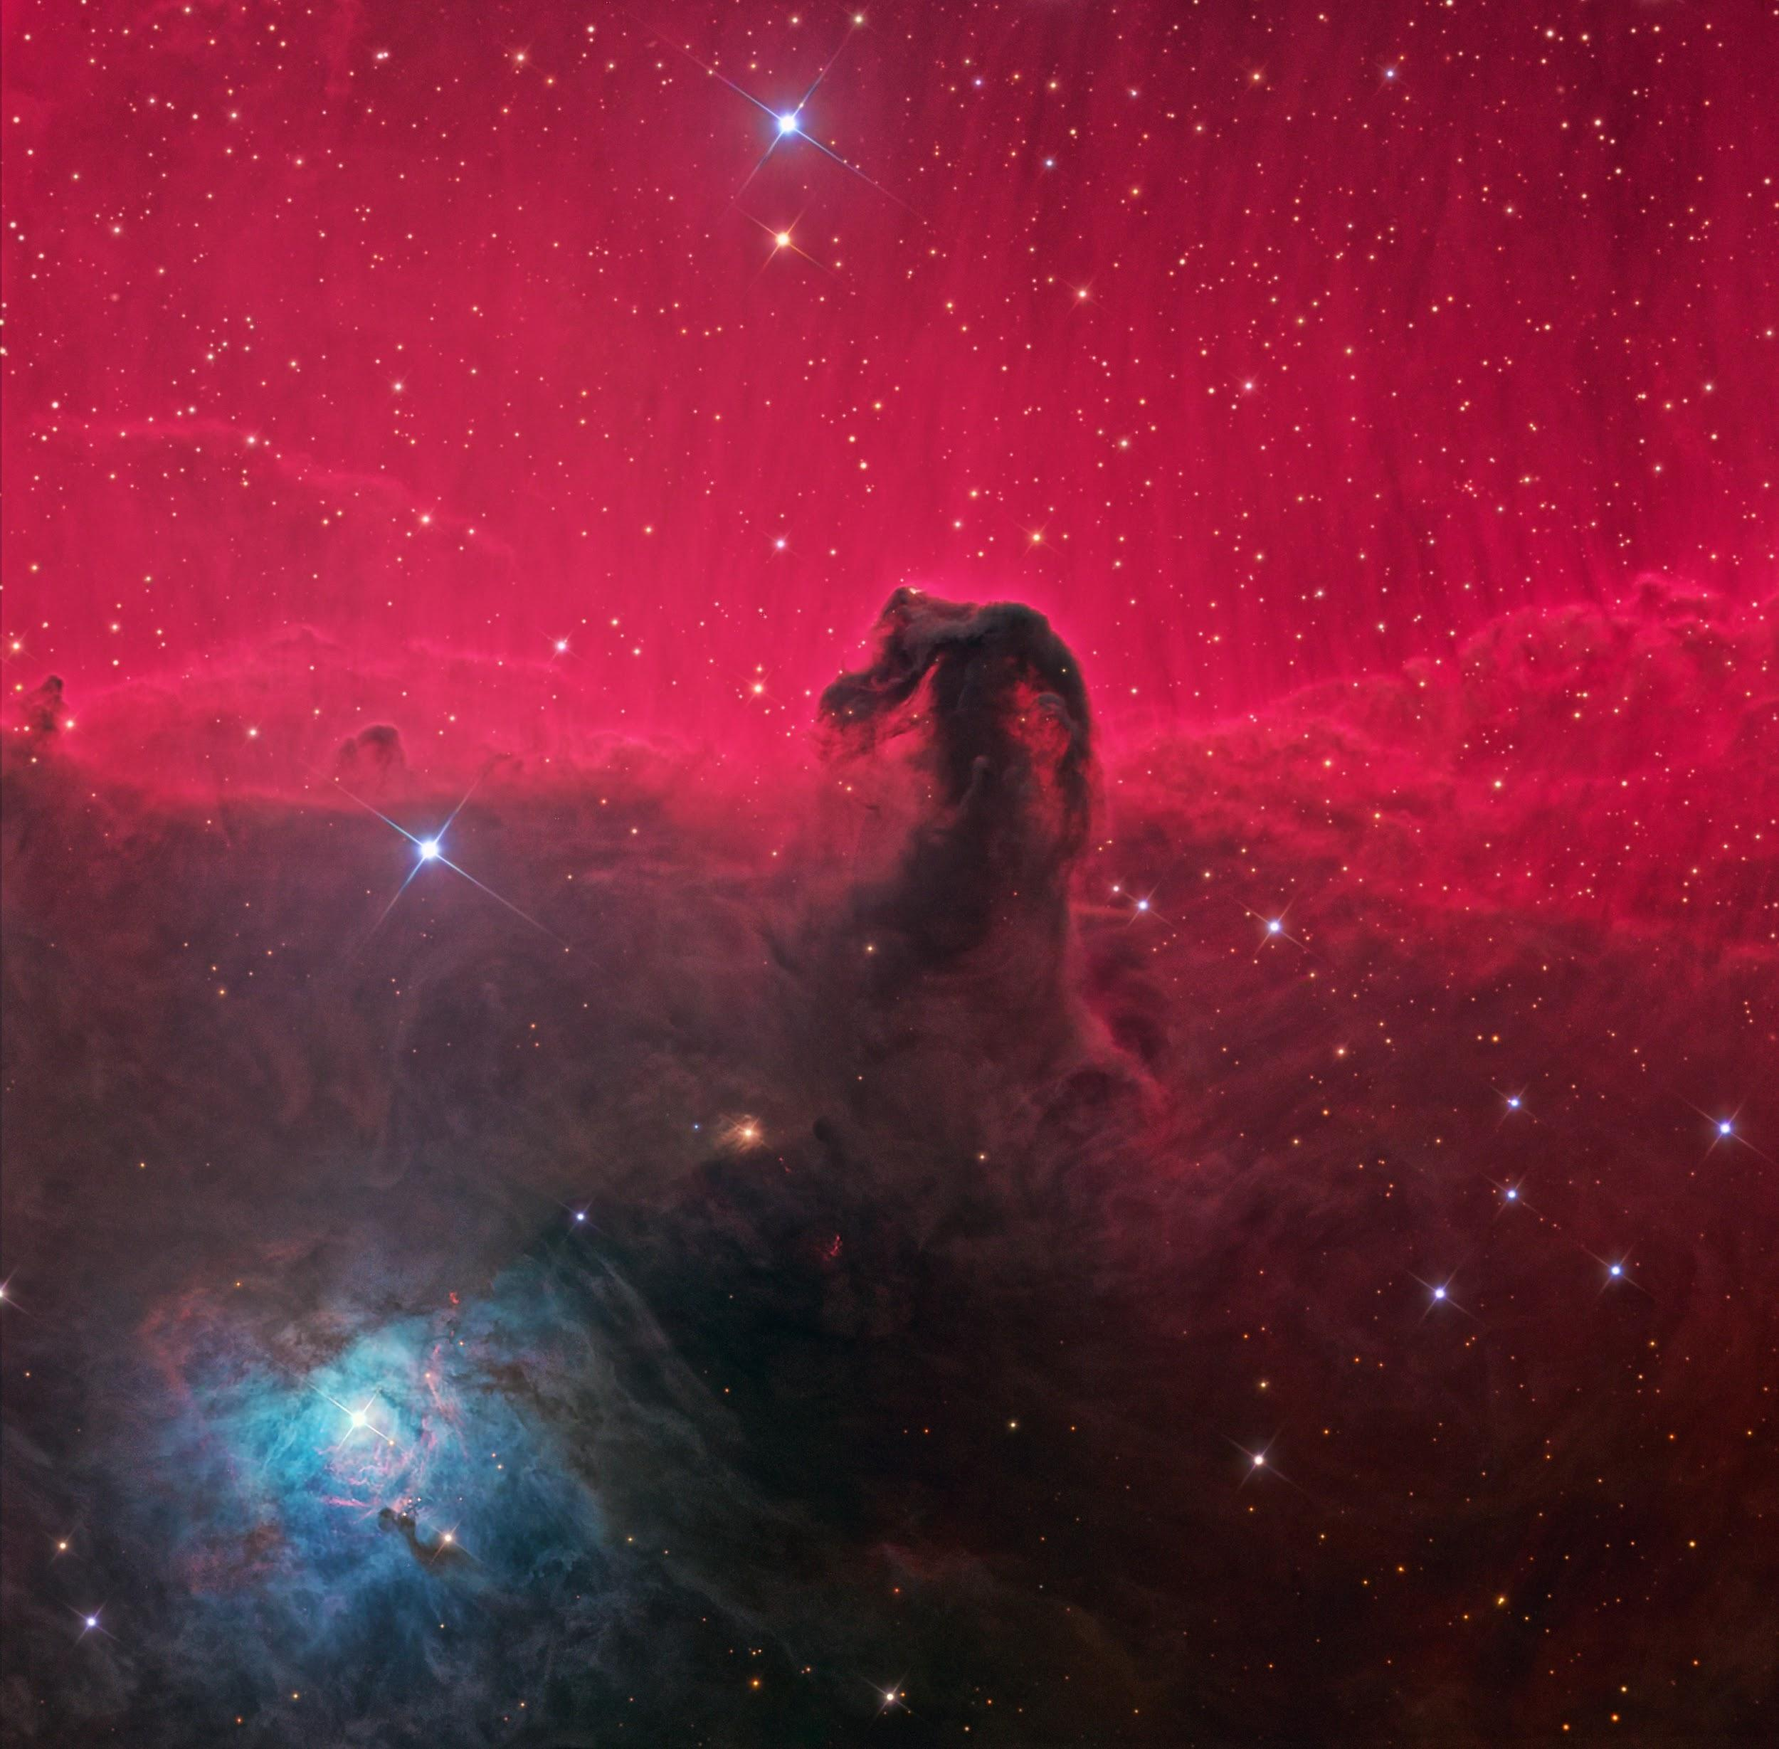
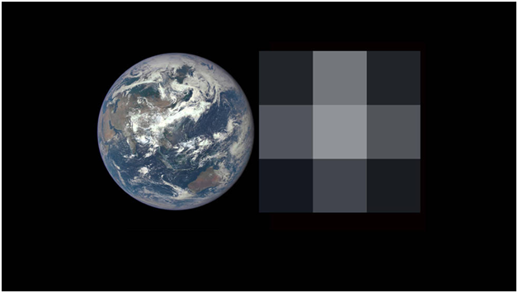
What does a planet look from millions of kms away?
Left, an image of Earth from the DSCOVR-EPIC camera. Right, the same image degraded to a resolution of 3 x 3 pixels, similar to what researchers will see in future exoplanet observations.

Slide 4
What is hard for humans to do?
Remember your girlfriend’s Birthday..
Calculate large numbers
Pass in M1..

Slide 5

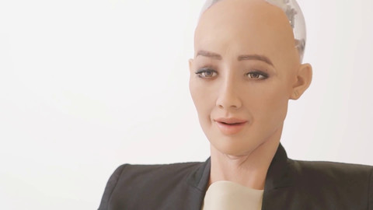
HARD for computers, EASY FOR US
EASY for humans, HARD for computers
Notes:
Analogy

Slide 6
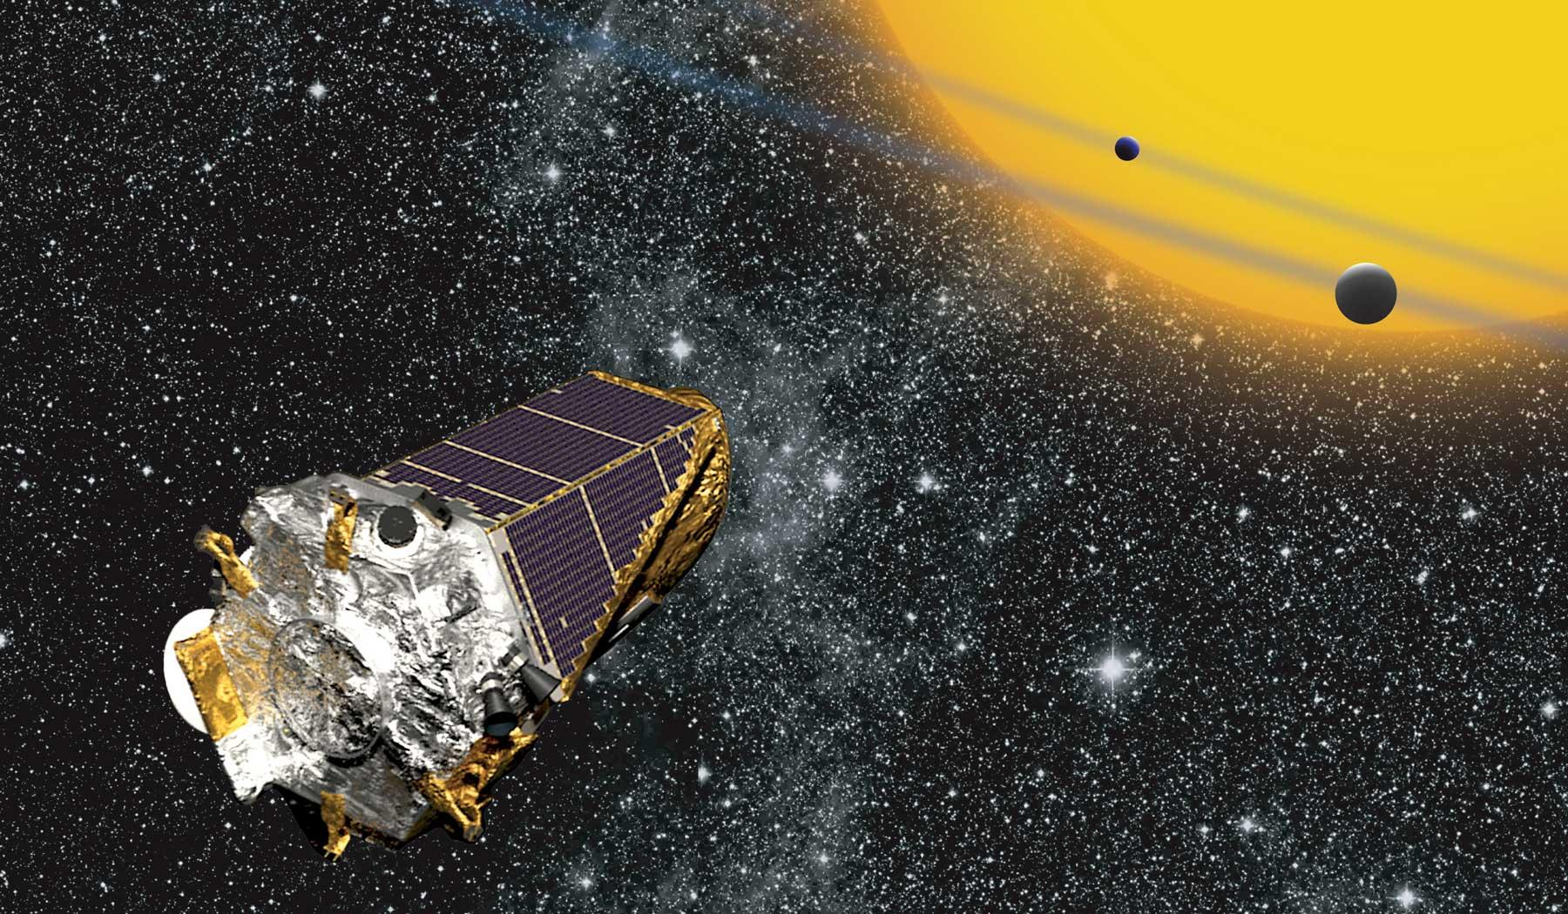
Radial velocity
Gravitational microlensing
Direct imaging
Polarimetry
Astrometry
Transit photometry

Slide 7
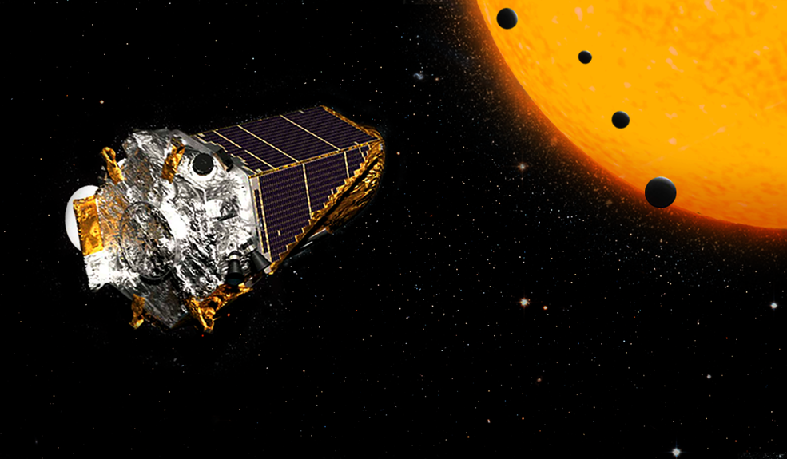
Transit Photometry

Slide 8
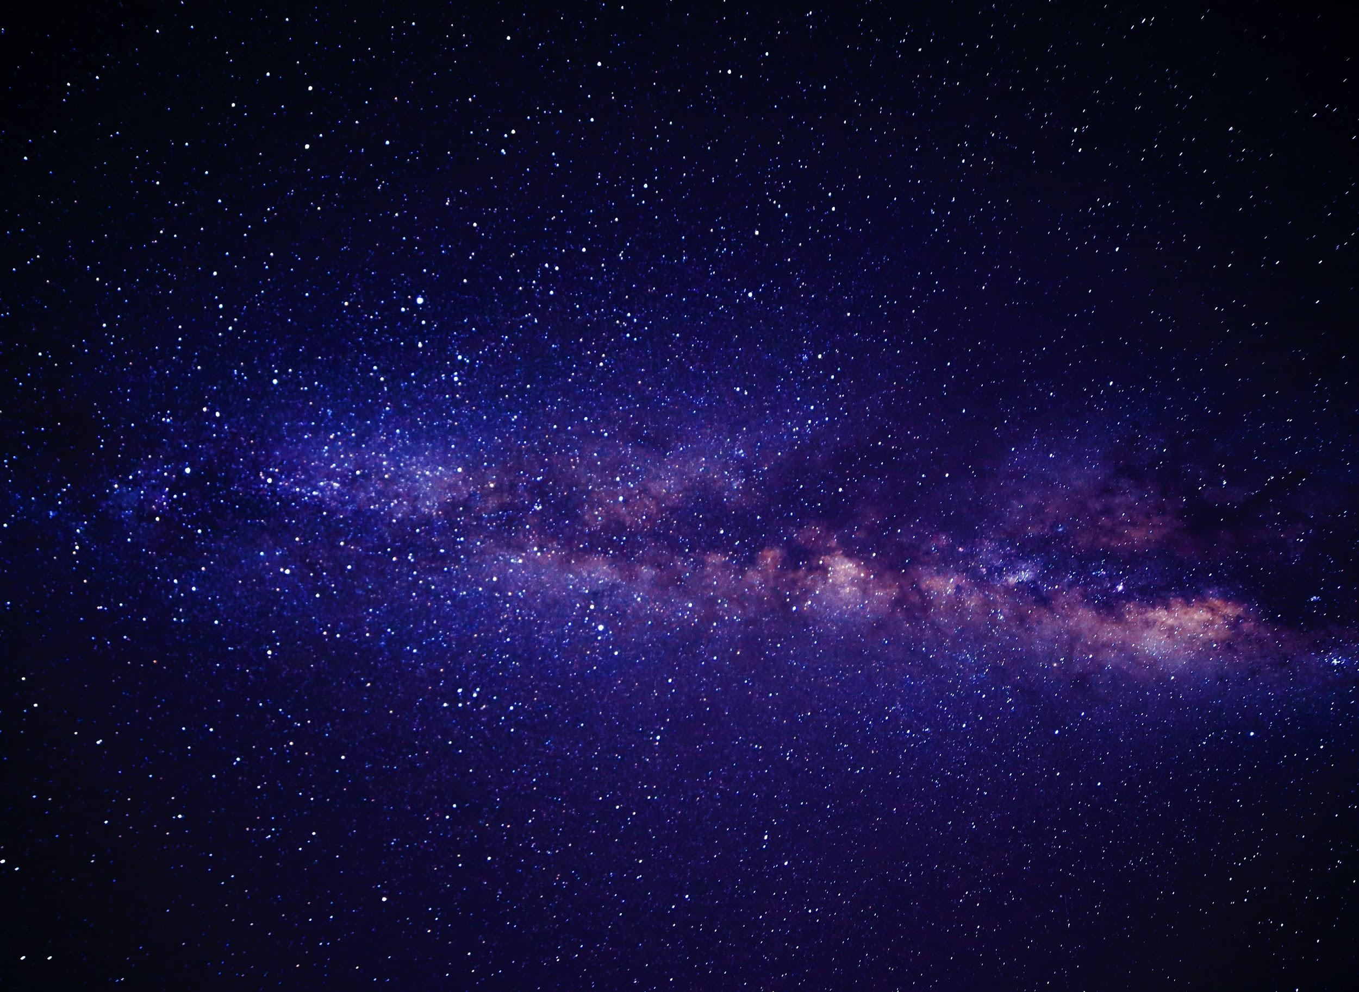

WHAT’S The Hiccup?
SO
Too much of data
Too MANY Rules!
Too Slow!
Not Reusable.

Slide 9
THE SOLUTION!!

Slide 10
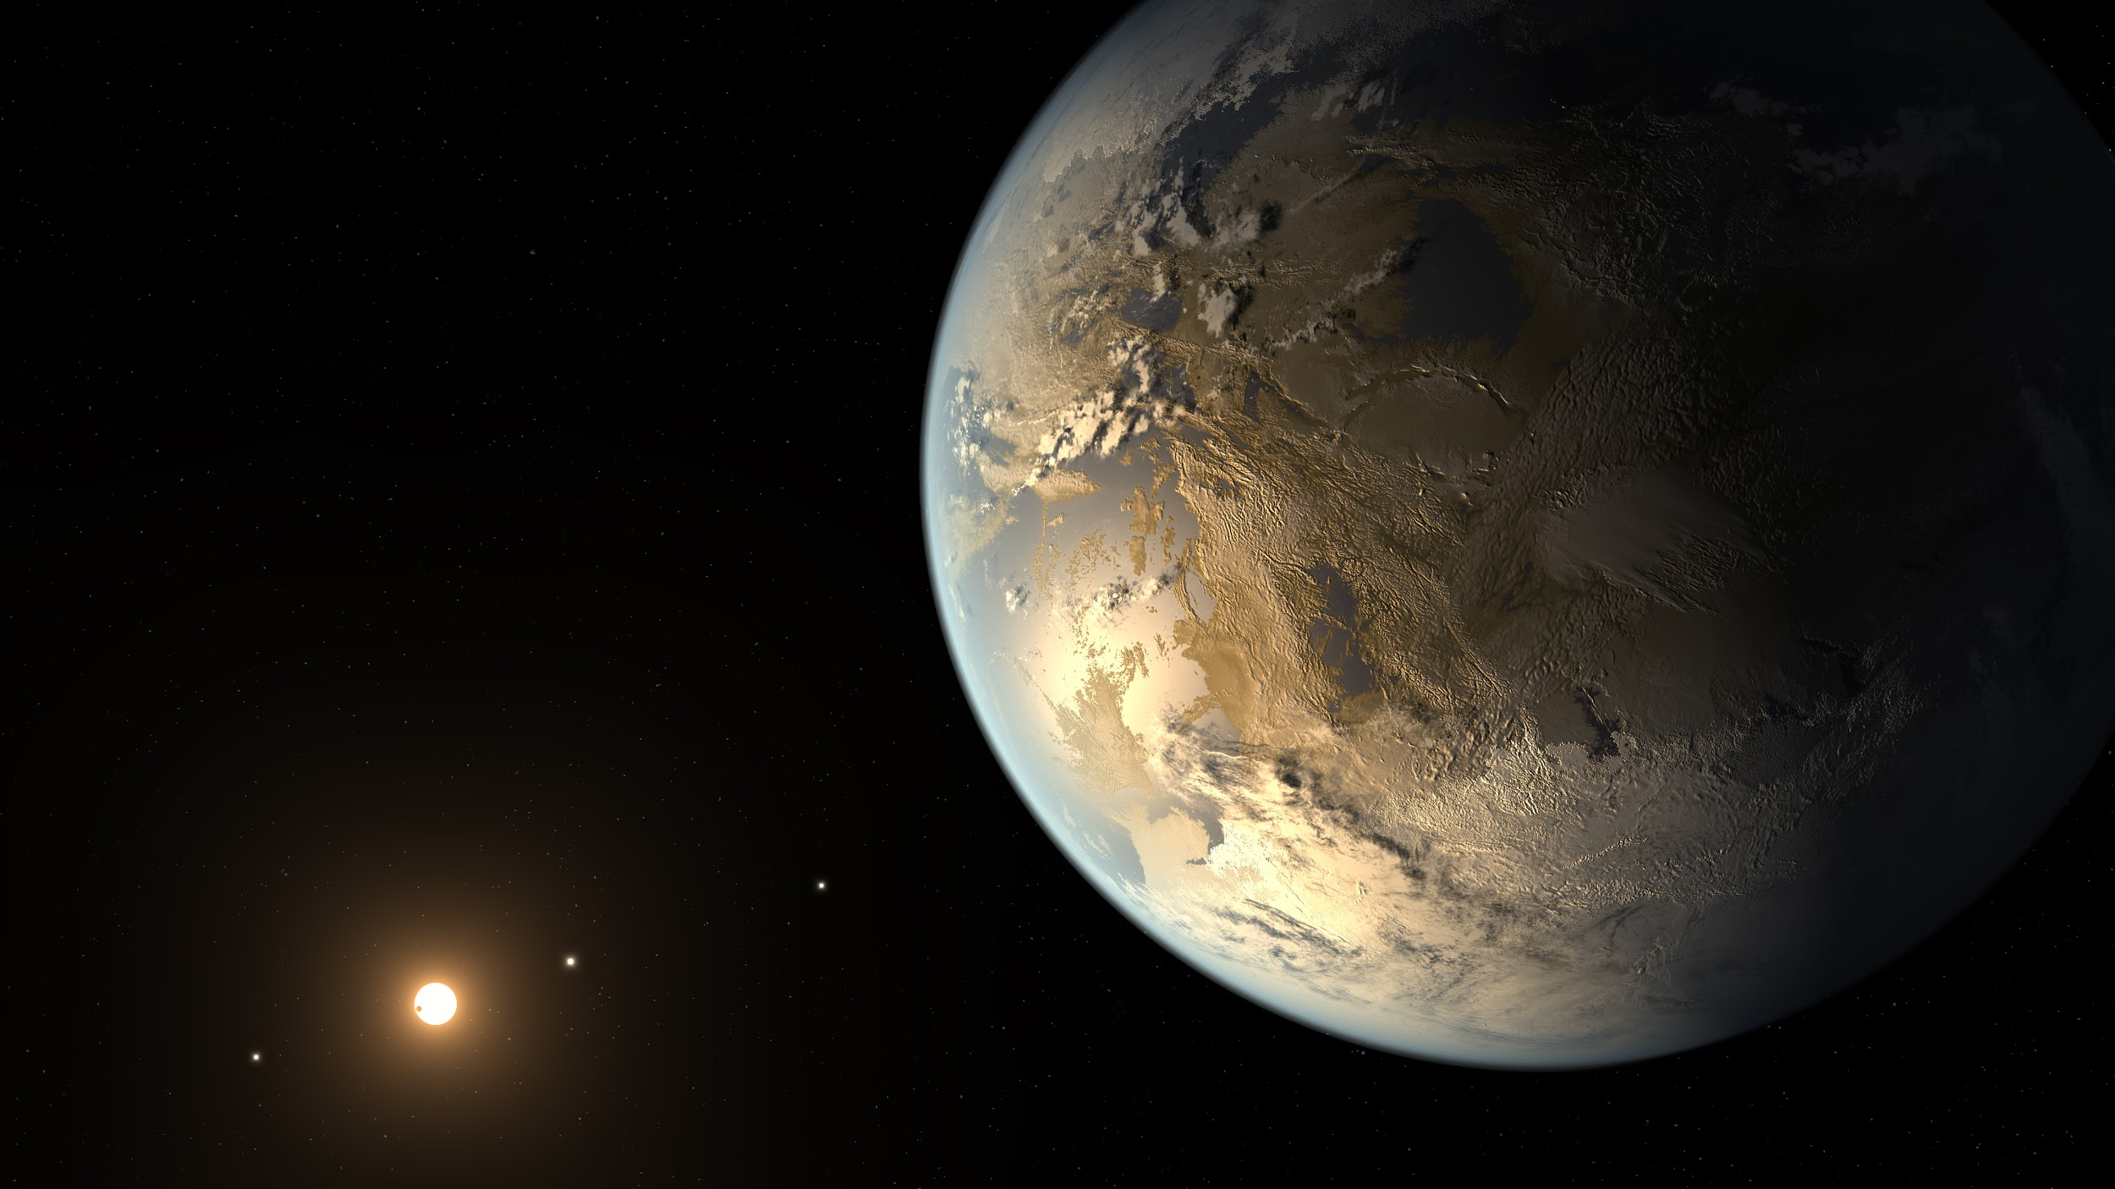

WHAT IS MACHINE LEARNING?
Notes:
The system was built using positive reinforcement - essentially, the machine was given an image and asked if the image was a cat. If the machine was correct, it was told so. But if the machine was wrong, the system was adjusted to recognize different patterns in an image so that it was more likely to get it right next time.

Slide 11
OUTPUT
INPUT
OUTPUT
INPUT
PROCESSING
PROCESSING

Slide 12
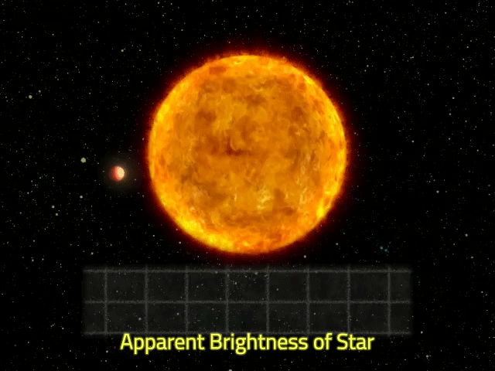
When the planet comes in front, there’s a dip in total brightness
Notes:
The dimming of a star during transit directly reflects the size ratio between the star and the planet: A small planet transiting a large star will create only a slight dimming, while a large planet transiting a small star will have a more noticeable effect. The size of the host star can be known with considerable accuracy from its spectrum, and photometry therefore gives astronomers a good estimate of the orbiting planet's size, but not its mass. This makes photometry an excellent complement to the spectroscopic method, which provides an estimate of a planet's mass, but not its size

Slide 13
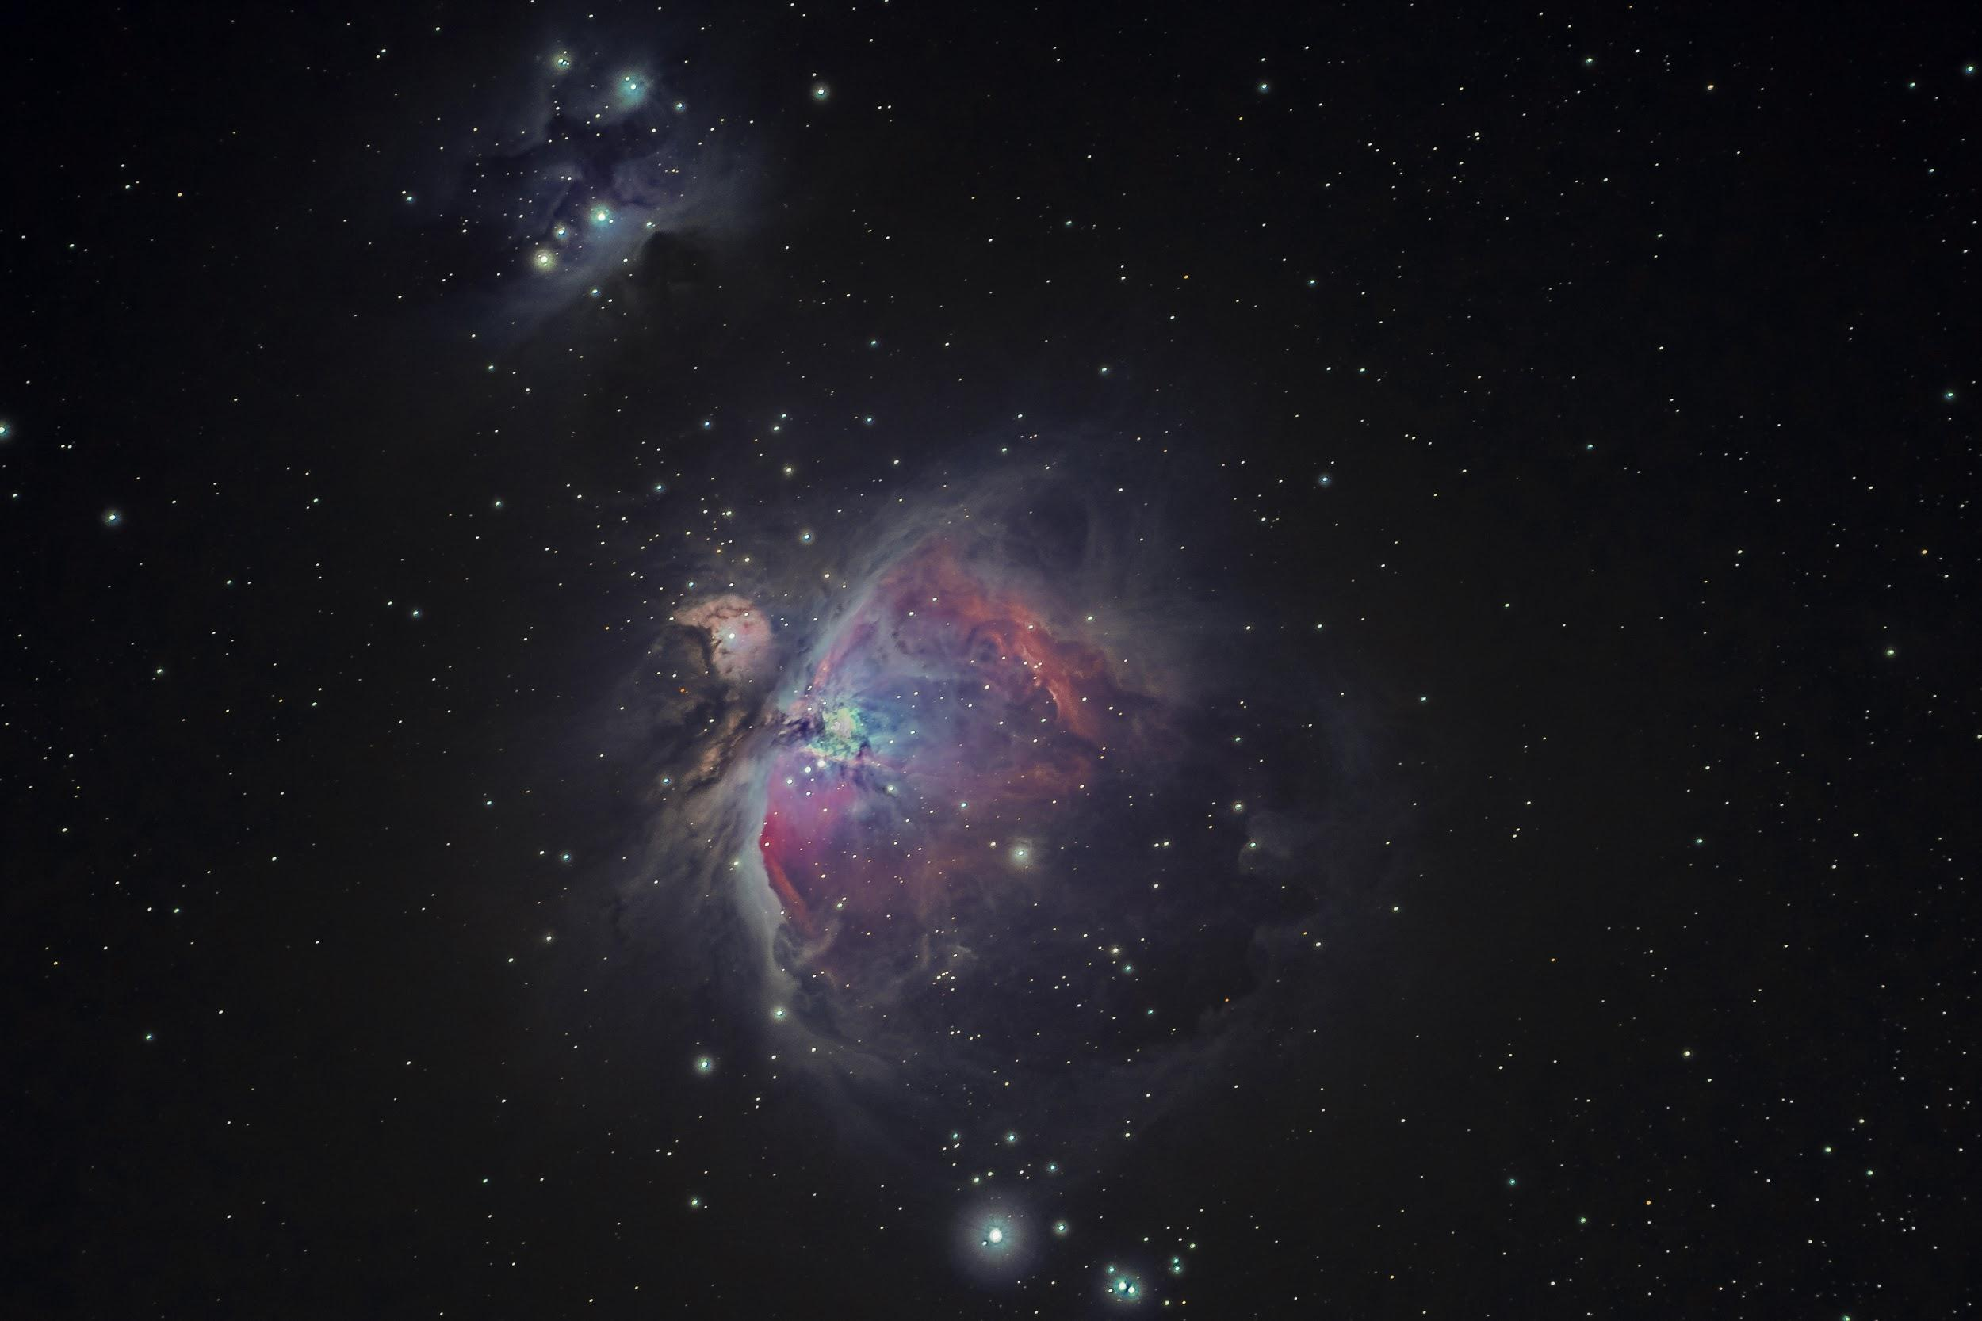
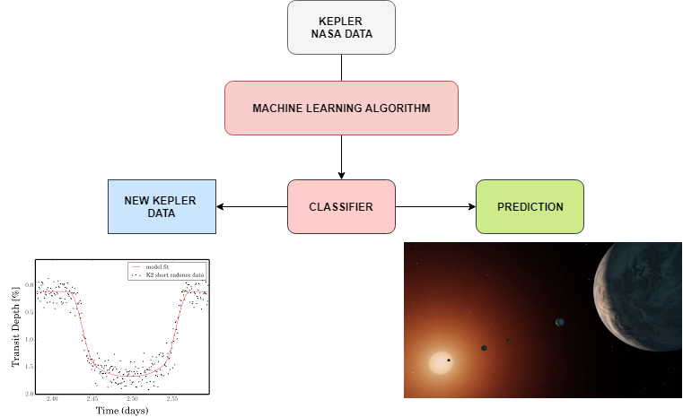

Slide 14
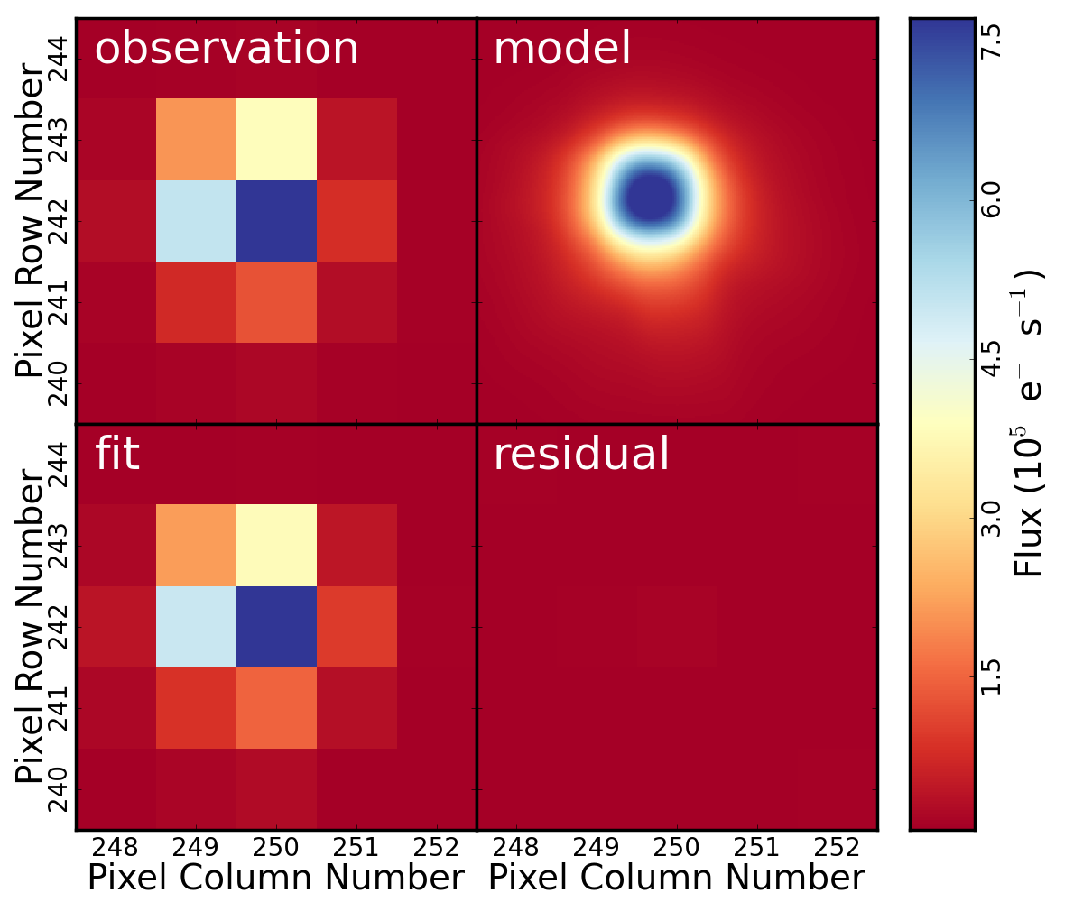

Slide 15
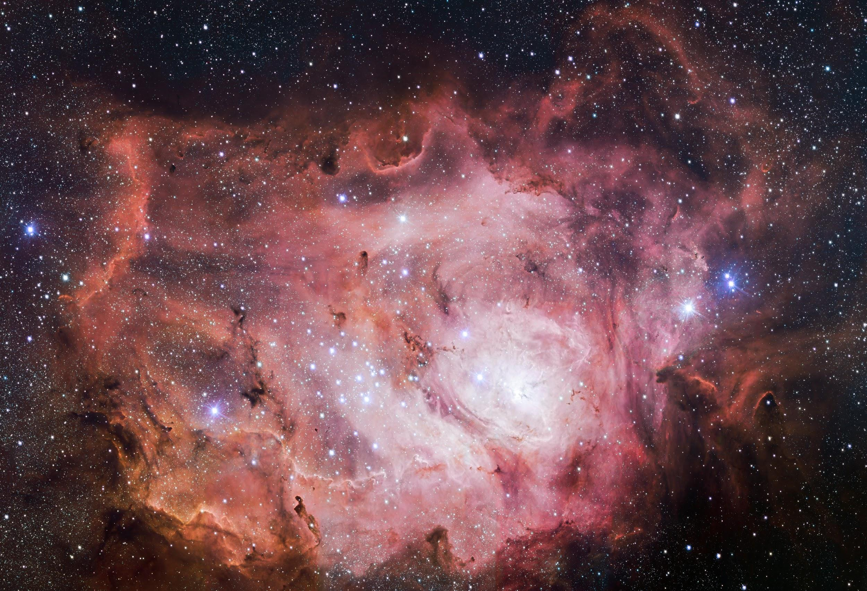


LOOP

Slide 16
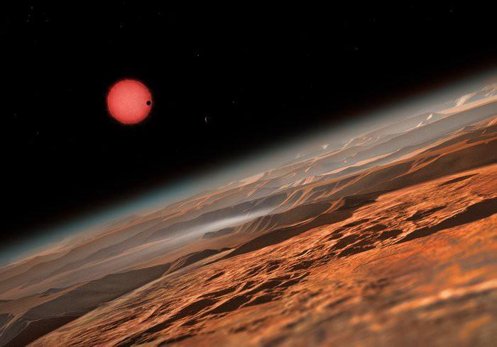
TRAPIST-1

Slide 17
SPACETECULAR
Thank You!
Notes:
Change the bg to milky way galaxy
Change the name

Slide 18

ttttTTo Infinity And Beyond!!

Slide 19
